Slide 1
84.51 Case Competition
Strategic Approaches for Kroger & National Branded Items

Slide 2
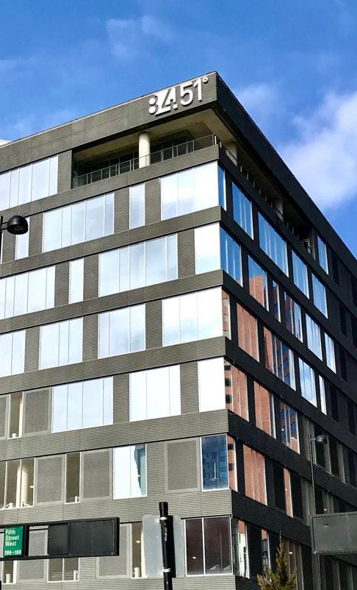




Our Team
Bharath Marturu
Hannah Latham
Kiet Ho
Matthew Walters

Slide 3
Data Assumptions:
Brands flagged as both Kroger and non-Kroger (23 out of 256) are categorized based on higher total spend under the respective flag.
01
The brand with a NULL label with a total spend of 3k was excluded from the analysis.
02
Data for February 2024 was omitted due to its incompleteness.
03

Slide 4
Product Categories
Dairy | Bakery | Meat & Seafood | Sushi | Fruits & Veg | Beverages | Grocery | Frozen
Milk | Bread | Ground Beef |  | Berries | Soda | Condiments | Frozen Prepared Chicken
Cheese | Cookies | Deli Chicken |  | Potato |  | Bagged Snacks | Frozen Meals
Yogurt |  |  |  | Salad Mixes |  | Dinner Mixes | Frozen Pizza
Eggs |  |  |  |  |  |  | Ice Cream

Slide 5
Consumer’s Thoughts During Inflationary Period
Consumers feel they are spending more to buy less
Volume for CPG’s is declining 3-4% on average
Units per trip declined by 3 to 5 percent across the grocery, health and beauty, and household categories

Slide 6
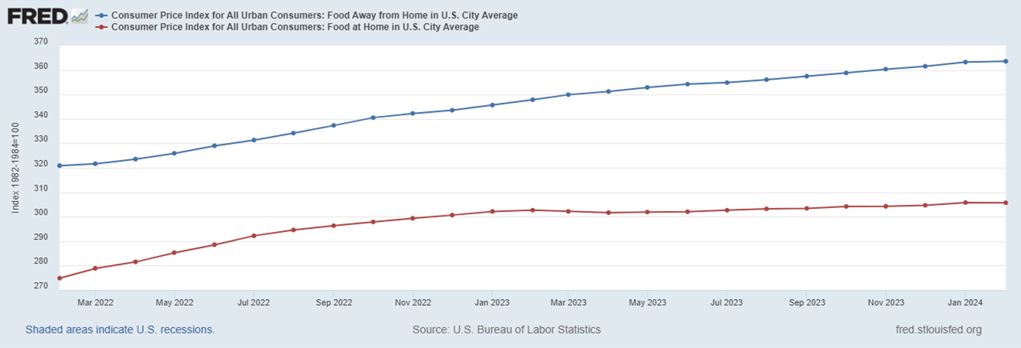
Food CPI Index Food Away from Home & Food at Home
Notes:
This trend suggests that the cost of dining out is experiencing a more notable upward pressure compared to grocery prices.
From a consumer perspective, this trend may imply that individuals and families could face higher expenses when dining out compared to preparing meals at home.

Slide 7
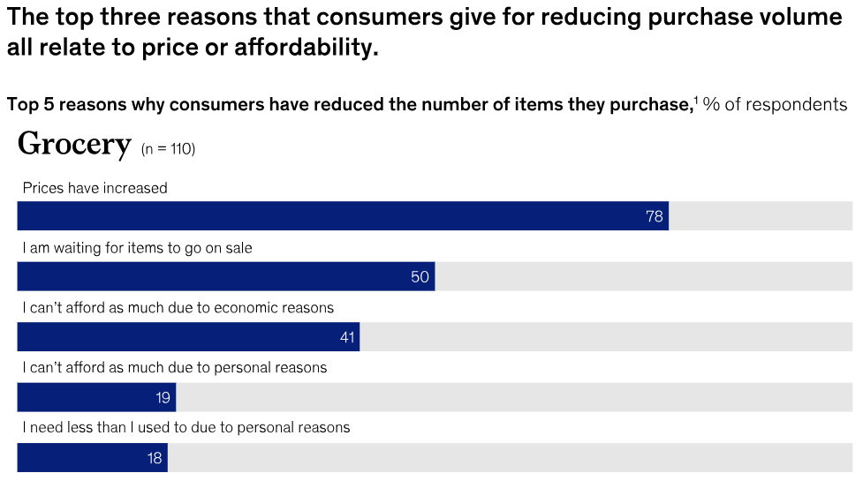
The 5 Reasons Why Consumers Have Reduced The Number of Items Purchased for Grocery

Slide 8
The Problem
If consumers are spending more to buy less, how can we create additional value for customers and influence sales during inflationary periods?
Notes:
As we discovered trends and behaviors among our customers, we reflected on our original customer concern of spending more to buy less and ask how we can create value additional value for customers during inflationary periods. We realized that we could create more value for our customers by influencing our customers toward purchasing a more optimal product mix (optimal for who-us or the consumer- yes (both)). By identifying areas in which consumers are willing to trade, we can nudge consumers to trade down creating a more balanced product mix. In turn creating more value for the customer because as they save in the areas they trade down in it creates more opportunity for them to trade up in the categories that are more important to them. Overall creating a more desirable $/value ratio for our customer.

Slide 9
Where National Brands Dominate
88.8%
71.6%
98.7%
Soda
Grocery
Frozen
Notes:
Based on the number of items purchased in comparison

Slide 10
Where Kroger Brands Dominate
97.9%
82.3%
Meat & Seafood
Dairy

Slide 11
Where it’s a toss-up
52.5% - National 47.5% - Kroger
57.8% - National 47.2 % - Kroger
Fruits & Vegetables
Bakery

Slide 12
Key Shifts in Customer Behavior
Average Time Between Visits
Total Spend Per Visit
Loyal 7 → 7 days
Convenience 8 → 9 days
Price Sensitive 8 → 10 days
Health & Quality 10 → 12 days
Loyal $15.32 → $15.82
Convenience $16.22 → $16.83
Price Sensitive $12.37 → $12.77
Health Concerned 11.43 → $11.90
Quality Concerned 11.54 → $11.96

Slide 13
Delivery vs Pickup Growth: Feb 2022 – Jan 2024
99.3%
43.1%
Delivery
Pickup

Slide 14
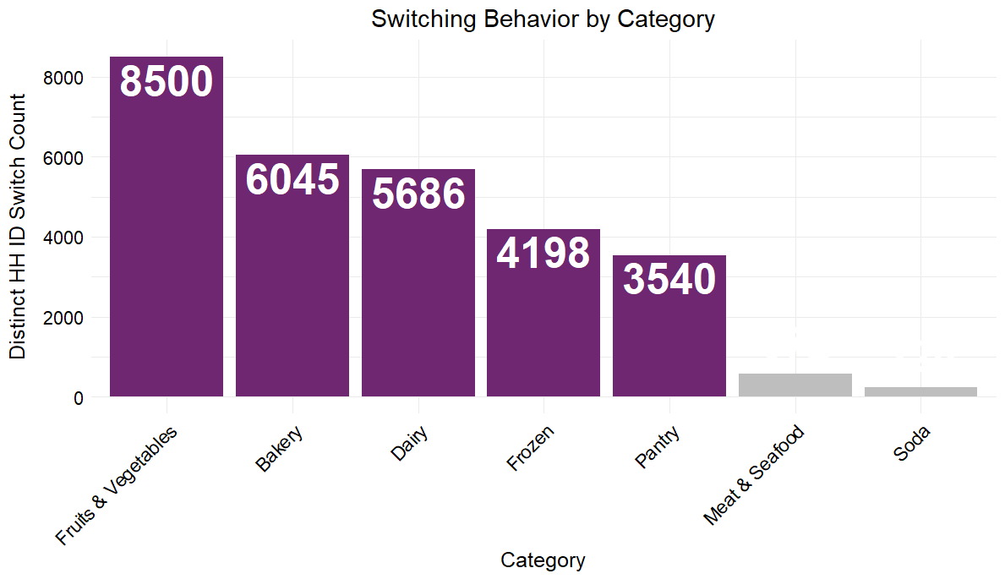
Switching Trends in Household Shopping Behavior by Category
Notes:
Look to add % of discounts here

Slide 15
Kroger and National brand items have a “symbiotic” relationship and complement each other
National brands help attract new customers
Private labels help differentiate players
Over 50% of transactions made by new customers included National brand
On average, 37% of customers prefer national brands over store brands
Built on trust and recognition
On average, Kroger brands offer 10% cheaper products after discount on a per item basis
Kroger’s meat and poultry products have a retention rate ranging from 80% - 90% by quarter throughout 2022 and 2023

Slide 16
The Problem
If consumers are spending more to buy less, how can we create additional value for customers and influence sales during inflationary periods?
Notes:
As we discovered trends and behaviors among our customers, we reflected on our original customer concern of spending more to buy less and ask how we can create value additional value for customers during inflationary periods. We realized that we could create more value for our customers by influencing our customers toward purchasing a more optimal product mix (optimal for who-us or the consumer- yes (both)). By identifying areas in which consumers are willing to trade, we can nudge consumers to trade down creating a more balanced product mix. In turn creating more value for the customer because as they save in the areas they trade down in it creates more opportunity for them to trade up in the categories that are more important to them. Overall creating a more desirable $/value ratio for our customer.

Slide 17
Customer Centered Design
Visceral
Behavioral
Reflective
Positive first impression
Provide consistency and address customer needs
Connect and encourage loyalty
Notes:
How do we nudge our customers to try KB products in the areas they are willing to trade down? Research suggests that consumers are more willing to try private-label products if they trust and are loyal to a store. This brings us to the next question, How do we create loyalty? We applied our strategy to the Customer Centered loyalty method to model our strategy as the method is based on the needs and wants of the consumer.
Visceral stage- allows for the design of the customer's initial response-this would be determined by our selected products and how we present them- price and quality our the biggest factors here (price is a heuristic for quality)
Behavioral- user interaction- emotional connotation is influenced significantly by convenience and user experience- by providing consistency and addressing customer needs as they interact with our products we can foster a positive user experience
Reflective- utilize customer feedback to connect and encourage loyalty through rewards

Slide 18
Strategy
Reward
Promote
Sample
Reward customer feedback
Promotions for sampled items to create value
Product sampling for positive impression
Notes:
By sampling the products we think consumers are willing to trade down on we can create a positive interaction with the customer and the product. As the customer centered design method suggest, price and quality are the biggest factors here. Since price is a heuristic for quality, by running promotions on the sampled products we can create added value for the customers.
How do we know if we are meeting customer expectations and needs? For the customers who purchase the promoted items, they will be promoted to give feedback on the products purchased. By providing this feedback, customers will be rewarded on a points system. As the customers earn points they can redeem the points for a free product. The free product can also been used to influence retention and promotion in identified categories.

Slide 19
Recommended Promotional Mix
Kroger Brand Items:
Bread
Potatoes
Condiments
Cheese
Salad Mix
National Brand Items:
Soda
Berries
Snacks
Yogurt
Notes:
Top 5 NB: Soda, berries, snacks, bread, -frozen pizza, yogurt

Slide 20
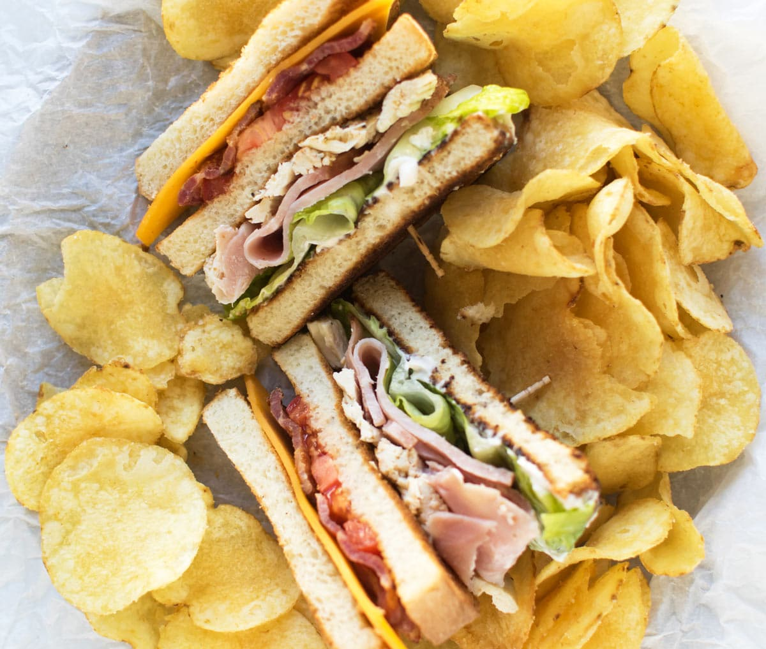
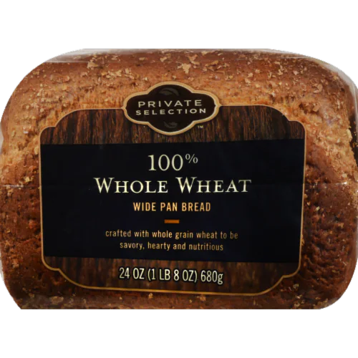
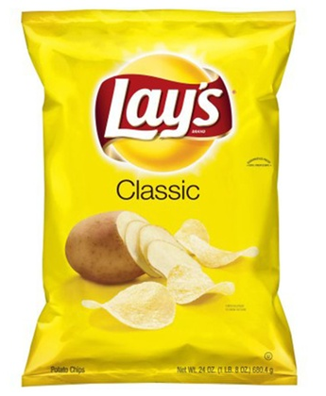
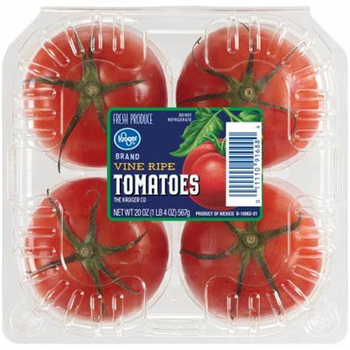
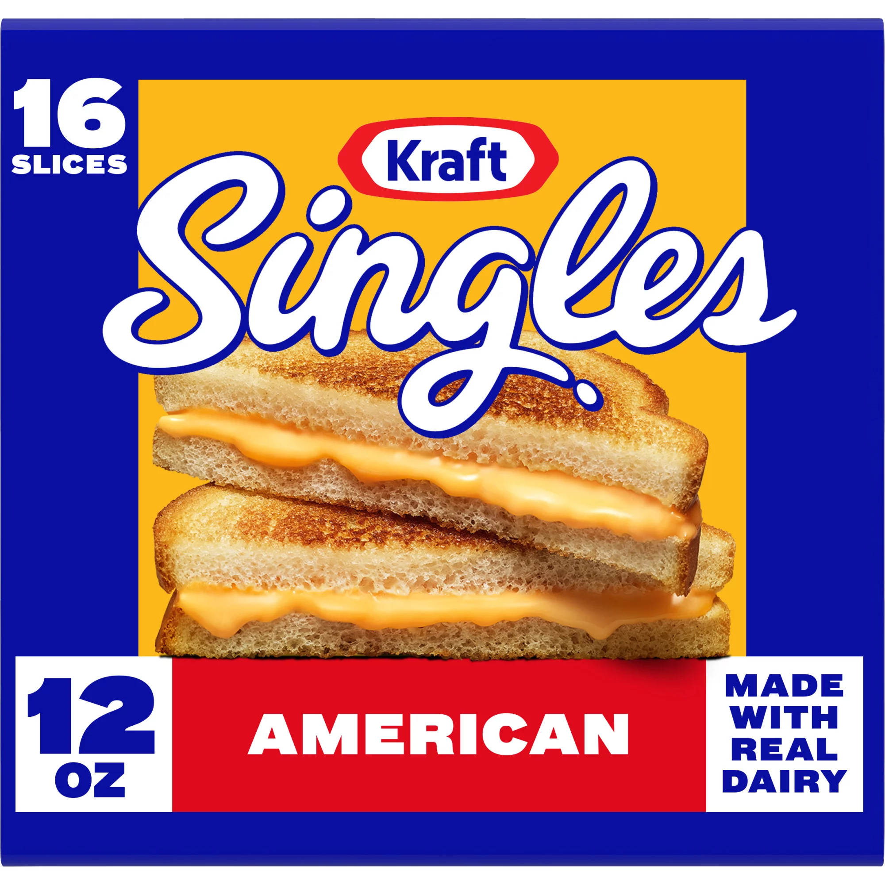
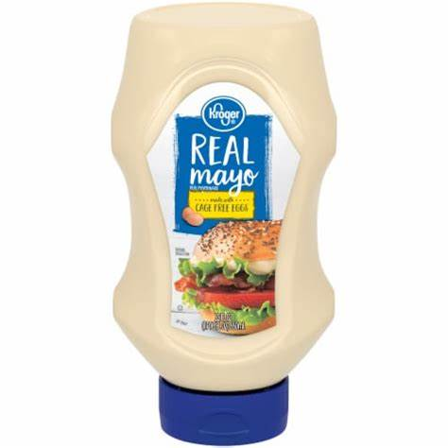
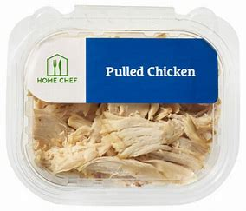
What's for dinner?
Cost Savings: $$
Time to make: >10 min.
Featured Products:
Notes:
Sampling sales statistics
Discounted sampled items, total meal cost metrics

Slide 21
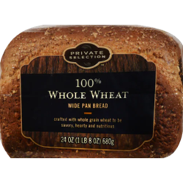

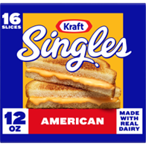


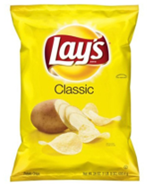
For pick-up and delivery?
Dinner in under 10 minutes:
Bundle and save on the ingredients:
Add to Cart
Notes:
Sampling sales statistics
Discounted sampled items, total meal cost metrics

Slide 22
The Benefit:
Value
Product Loyalty
Profitability
Notes:
A more optimal product mix of KB and NB creates more value for our customers
By creating product loyalty to KB you will also create store loyalty
Increasing customer retention increases profitability (increasing retention by 5% can increase profits by 25-95%)

Slide 23
Special Thanks
Dr. Roseann Hassey
&
Professor Delmer "Bill" Nicholson

Slide 24
Questions?

Slide 25
Resources
Adams, Christina, et al. “Consumers: Spending More to Buy Less.” McKinsey & Company, McKinsey & Company, 16 Feb. 2024, www.mckinsey.com/industries/consumer-packaged-goods/our-insights/consumers-spending-more-to-buy-less.
“Consumer Digest: Behavior Insights - Saving vs. Splurging August 2023.” Consumer Digest: Behavior Insights - Saving vs. Splurging August 2023 | 84.51°, www.8451.com/knowledge-hub/insights-and-activation/consumer-digest-behavior-insights-saving-vs-splurging/. Accessed 5 Apr. 2024.
Gazquez-Abad, Juan Carlos, et al. Advances in National Brand and Private Label Marketing 10th International Conference, 2023. Springer International Publishing AG, 2023.
Pinsker, Joe. “The Psychology behind Costco’s Free Samples.” The Atlantic, Atlantic Media Company, 1 Oct. 2014, www.theatlantic.com/business/archive/2014/10/the-psychology-behind-costcos-free-samples/380969/.
Qian, Zhe, and Cunyuan Yang. “A study of customer loyalty build up method based on customer centred design.” SHS Web of Conferences, vol. 181, 2024, p. 01050, https://doi.org/10.1051/shsconf/202418101050.

